Slide 1

The Rise of Agentic AI:Building Proactive, Autonomous Systems
Presenter: Ravi

Slide 2
Today's Journey
01
02
03
The Agentic AI Paradigm Shift
Foundations of AI Agents
Anatomy of an AI Agent
Understanding the core shift from reactive to proactive systems.
Exploring LLMs and RAG as crucial building blocks.
Key components that define an intelligent agent.
04
05
06
CrewAI: Orchestrating Agent Teams
Live Demo: Automated Email Workflow
Ethical AI Agents
Building Agents with giving right context in Ethical way.
How the CrewAI framework enables multi-agent collaboration.
Seeing agentic AI in action with a practical example.
07
Key Takeaways & Q&A
Summarising core concepts and addressing your questions.

Slide 3

Why Agentic AI Changes Everything
What Makes Agentic AI Different?
Proactive Decision-Making
Autonomous Problem Solving
Agents initiate actions and make decisions based on high-level goals, not just immediate prompts, driving towards objectives autonomously.
They can break down complex tasks, self-correct errors, and adapt their strategies dynamically to new information and changing environments.
Orchestrated Workflows
Reduced Human Overhead
Multiple agents can coordinate and collaborate intelligently, forming sophisticated workflows to achieve overarching business objectives efficiently.
By handling repetitive or complex operational tasks, agentic AI frees software engineers to focus on higher-level strategy, innovation, and creative problem-solving.

Slide 4

The Evolution of Artificial Intelligence
Traditional AI
Machine Learning
Rule-based, reactive systems
Predictive, data-driven models
Examples: calculators, spam filters
Examples: recommendation engines
Large Language Models
Agentic AI
Language understanding and reasoning
Goal-driven, proactive, autonomous
Examples: ChatGPT, Gemini
Examples: AI assistants booking flights end-to-end
📈 From simple inputs & outputs → autonomous workflows

Slide 5




From Reactive to Proactive Systems
Traditional AI
Large Language Models
Agentic AI
One input → One output
Understand & generate human-like text
Plans, acts, adapts to goals
Example: "Translate text" → returns translation
Example: "Summarise this report" → coherent summary
Example: "Schedule a meeting" → finds slots, checks calendars, sends invites
🧠 The Paradigm Shift
AI transforms from passive responder to autonomous problem-solver

Slide 6

LLMs: The Foundation Layer
LLMs are the Brain
They reason, plan, and generate human-like language with remarkable sophistication
But LLMs Alone Aren't Agents
Memory: Forget after each query
Tools: Can't act without APIs
Autonomy: Only respond, never initiate
How LLMs Function
Learn patterns from massive training datasets
Generate responses using internal parameters
Limited by static training knowledge
🔑 Agentic AI = LLM + Memory + Tools + Autonomy

Slide 7
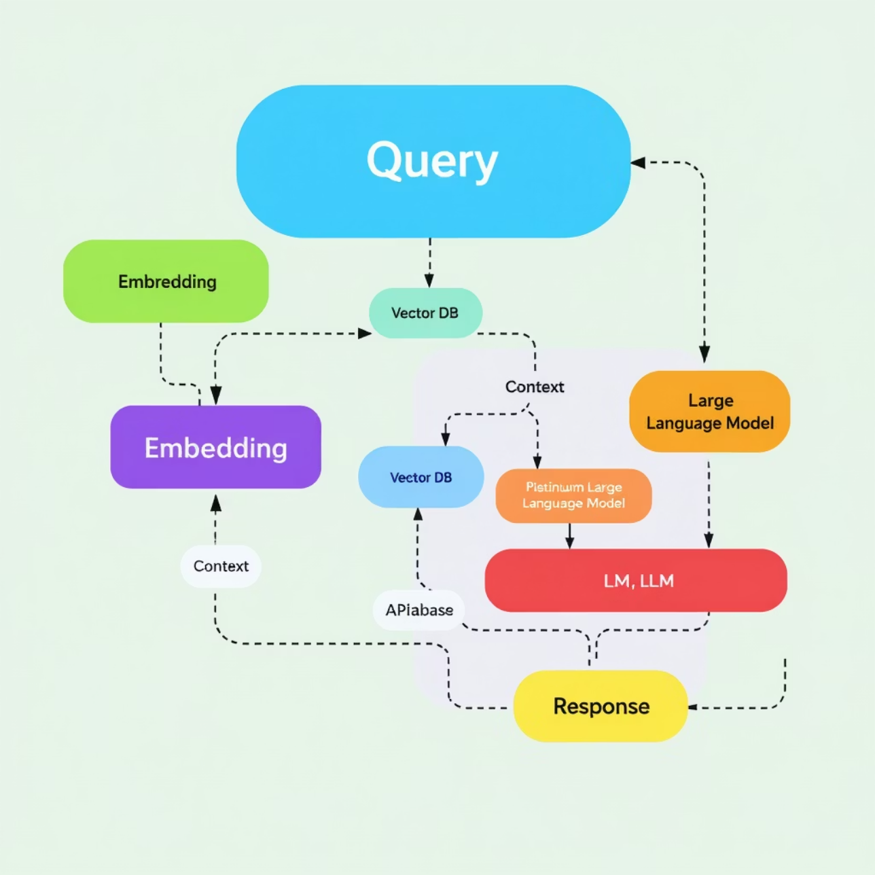
RAG: Bridging Static and Dynamic Knowledge
Retrieval-Augmented Generation
Extends LLMs with External Knowledge
Runtime Context Retrieval
Connects to vector databases, search engines, and live documentation
Retriever pulls relevant information → LLM uses it for enhanced responses
Dynamic Information Access
Bridges gap between static training data and real-time information needs

Slide 8









The Anatomy of an AI Agent
Agentic AI goes beyond answering → it plans, reasons, and executes
LLM (Brain)
Memory System
Plans strategies and reasons through complex problems
Short-term: task context
Long-term: knowledge/history
Orchestration (Heart)
Tools (Hands)
Decides next actions, delegates tasks, coordinates workflows
APIs, databases, email, search engines, code execution environments
📌 Think: "A personal assistant with memory, tools, and initiative"

Slide 9




CrewAI: Orchestrating AI Teams
Multi-Agent Collaboration Framework
CrewAI is a Python framework designed for coordinating multiple AI agents working together
Agent
Specialised worker (researcher, writer, coder) with defined roles and capabilities
Task
Assigned work units (research trends, draft emails, generate reports)
Crew
Manager that coordinates agents, assigns tasks, and ensures completion
⚙️ Transforms LLMs into a "team of specialists"

Slide 10

CrewAI Components in Action
Example: Market Research Agent Implementation
Agent Configuration
1
Role: Research Analyst - Market Trends Expert
Goal: "Find latest AI adoption statistics and industry insights"
Tools: GoogleSearch API, WebScraper, DataProcessor
Task Definition
2
Description: "Summarise top 3 AI trends from 2024 Q4 with supporting data"
Expected Output: Structured Markdown report with citations and sources
Context: Focus on enterprise adoption patterns
Crew Orchestration
3
Coordination: Brings together tasks and agents seamlessly
Execution: Runs workflows in sequence or parallel as needed
Quality Control: Validates outputs and ensures task completion

Slide 11




Live Demo: Automated Email Workflow
Witness Agentic AI in action with a practical scenario:
Script Walkthrough
Agent Collaboration
Real-time Outcome
We'll examine the CrewAI script, defining agents, roles, tools, and the overall workflow.
See how tasks are delegated, agents interact, and progress towards the defined goal.
Observe the human approval step and the automatic email dispatch triggered by the AI crew.

Slide 12
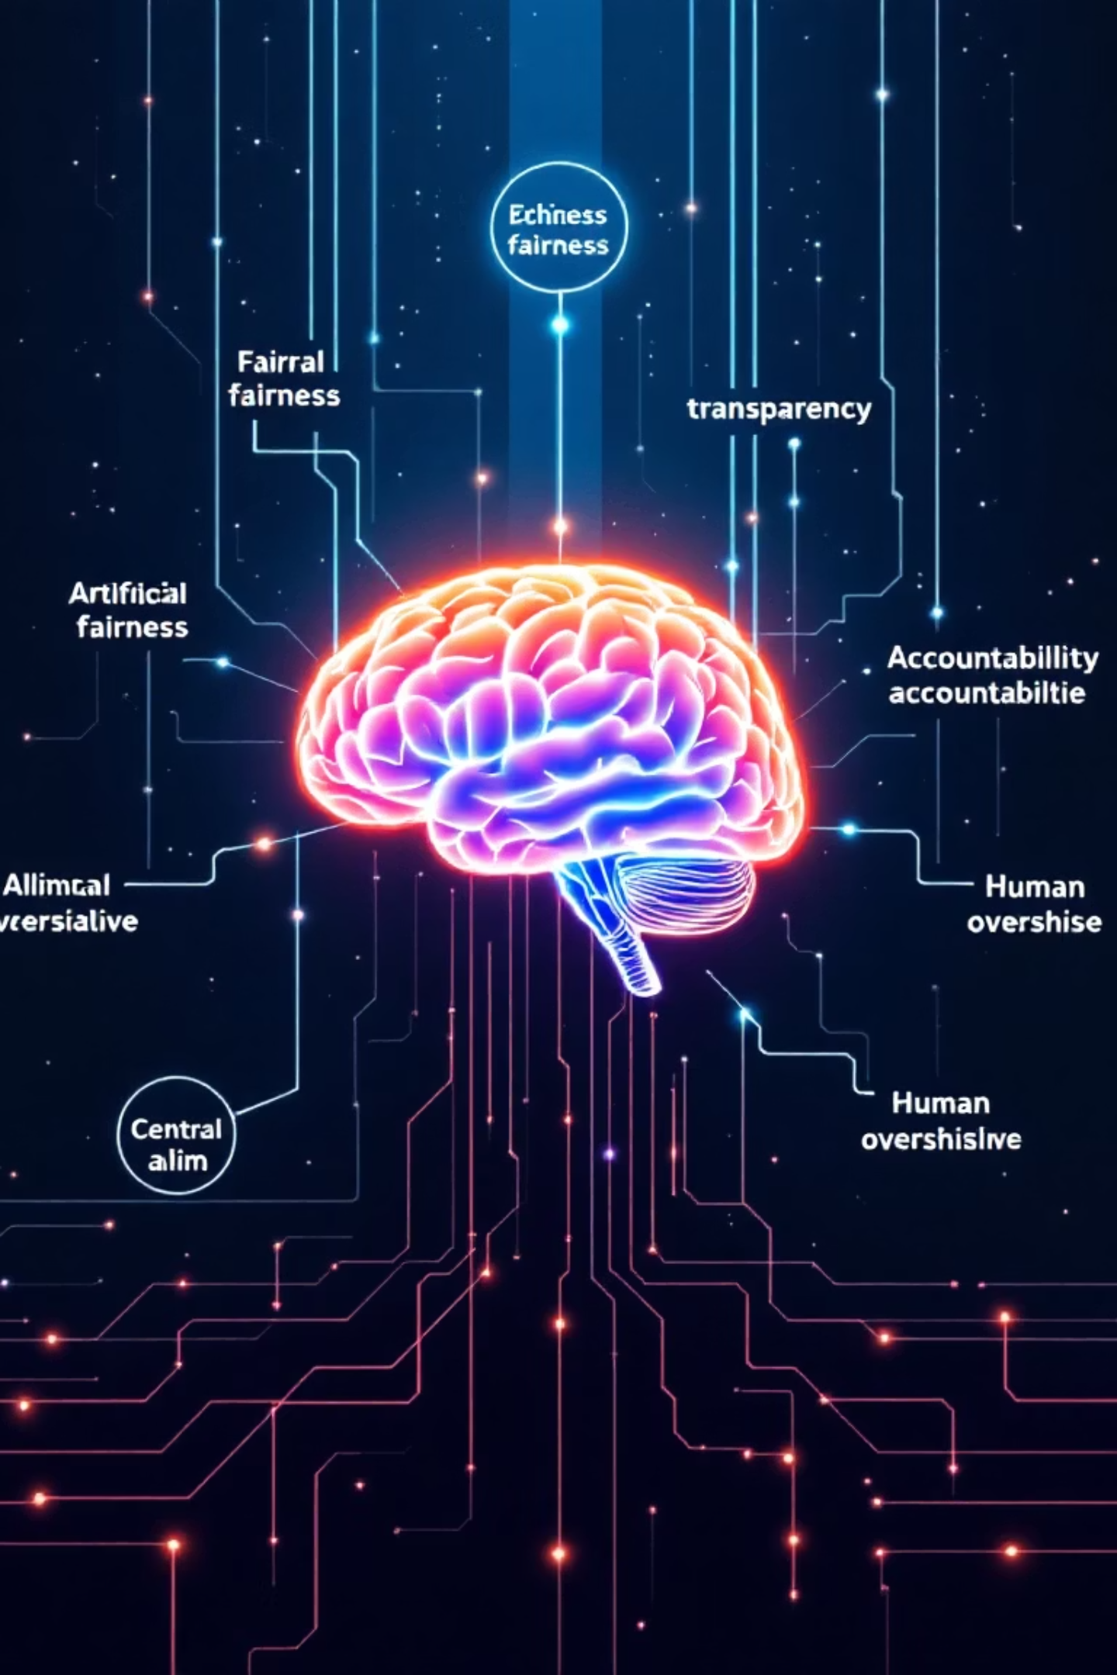
Ethical AI Agents: A Crucial Imperative
Fairness & Bias Mitigation
Ensuring AI agents operate without prejudice and promote equitable outcomes for all users.
Transparency & Explainability
Designing agents whose decision-making processes can be understood and audited.
Accountability & Control
Establishing clear lines of responsibility for agent actions and maintaining human oversight.
Privacy & Data Security
Protecting sensitive information handled by autonomous agents and adhering to data regulations.

Slide 13





Key Takeaways / Recap
Recap of our journey into the world of Agentic AI:
Agentic AI: The New Paradigm
LLMs Powering Autonomy
AI systems are evolving from reactive tools to autonomous, proactive problem-solvers that plan, reason, and execute.
Large Language Models are the 'brain', but agents add critical components like memory, tools, and orchestration for true initiative.
RAG for Dynamic Knowledge
CrewAI: Orchestrating AI Teams
Retrieval-Augmented Generation bridges the knowledge gap, providing LLMs with real-time, external information beyond their training data.
Frameworks like CrewAI enable the coordination of multiple specialised AI agents to work collaboratively on complex tasks.

Slide 14



Future of Software
Agentic AI is set to fundamentally redefine software development and application capabilities:
Engineers as Orchestrators
Adaptive, Proactive Applications
Seamless Human-AI Collaboration
The focus shifts from manual coding to designing and managing sophisticated multi-agent systems, where engineers become architects of AI collaboration.
Software will no longer just respond to commands but will proactively anticipate needs, plan solutions, and execute tasks autonomously, learning and adapting continuously.
Future applications will blend human creativity and intuition with AI's efficiency, augmenting our abilities and streamlining complex workflows across all industries.
🚀 This paradigm shift empowers us to build more intelligent, resilient, and human-centric software.

Slide 15

References and Links
Explore the resources and code used in this presentation to deepen your understanding of Agentic AI:
Resources:
Getting Started with AI Toolkit (PDF)
Code:
Automated Email Agent Demo (Python)

Slide 16

Questions?
Thank you for your time!

